Slide 1
MULTI TIER ARCHITECTURE USING AWS
CAR PARKING BOOKIING SYSTEM
M SATHISHKUMAR
Class time : 3.30 PM To 5.00 PM
Joining date : 06.03.2026

Slide 2
INDEX
Introduction
Objectives
Architecture overview
Diagram
Technologies used
AWS Components used
Implementation steps
Working flow
Conclusion

Slide 3
INTRODUCTION
Multi-tier architecture is a software design pattern that separates an application into different layers (tiers). Each tier has a specific responsibility, improving scalability, security, and maintainability.
In this project, we developed a Car Parking Booking System using a 3-tier architecture:
Frontend (Presentation Layer)
Backend (Application Layer)
Database (Data Layer)

Slide 4
OBJECTIVES
The main objectives of this project are:
To understand multi-tier architecture
To build a scalable web application
To separate frontend, backend, and database
To deploy using cloud services (AWS)

Slide 5
ARCHITECTURE OVERVIEW
Frontend (Presentation Layer)
Built using HTML, CSS, JavaScript
Hosted using NGINX
User interacts with this layer
Backend (Application Layer)
Built using Phython3
Handles API requests
Processes booking car data
Database (Data Layer)
MySQL
Store car booking details

Slide 6
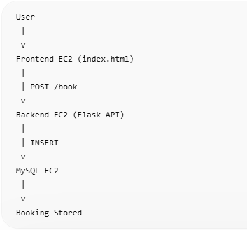
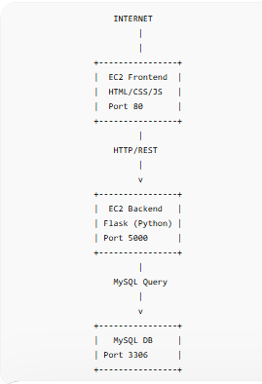
DIAGRAM

Slide 7
TECHNOLOGIES USED
Frontend: HTML, CSS, JavaScript
Backend: Phython3
Web Server: NGINX
Database: MySQL
Cloud Platform: Amazon Web Services
Compute: EC2 Instances
Networking: Subnets

Slide 8
AWS COMPONENTS USED
Public Subnet – for frontend (NGINX server)
EC2 Instances – to host frontend and backend
MySQL – for database
Security Groups – firewall rules

Slide 9
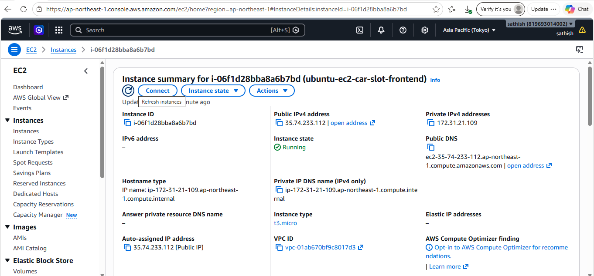
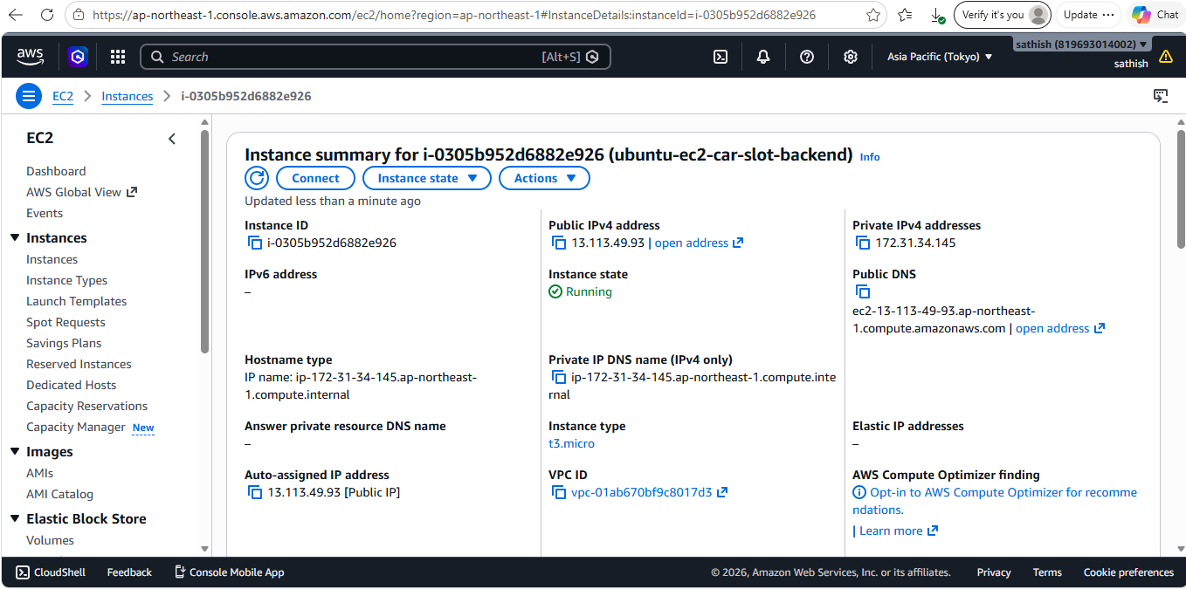

Slide 10
Install NGINX (frontend)
sudo apt update
sudo apt install nginx -y
sudo systemctl start nginx
sudo systemctl enable nginx
sudo systemctl status nginx
ubuntu@ip-172-31-21-109:~$ cd /var/www/html
-rw-r--r-- 1 root root 1176 May 30 17:53 index.nginx-debian.html
-r-------- 1 root root 1675 May 30 17:56 keypair.pem
ubuntu@ip-172-31-21-109:/var/www/html$ sudo nano index.nginx-debian.html
sudo nano keypair.pem
sudo chmod 400 keypair.pem

Slide 11

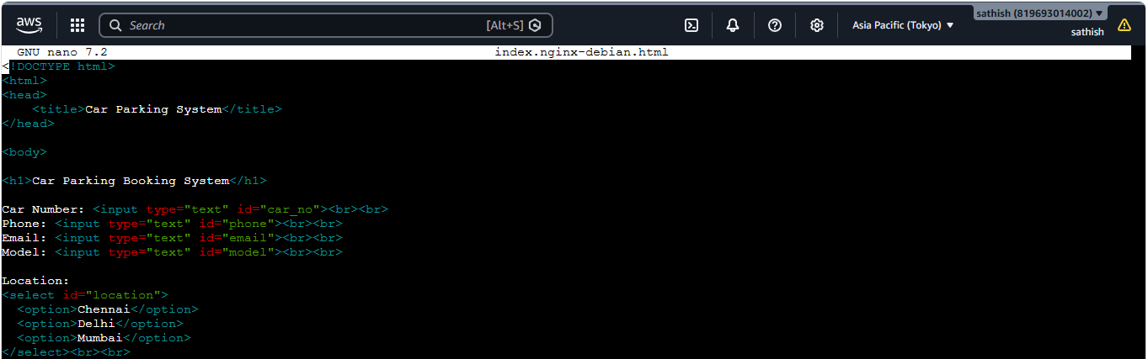
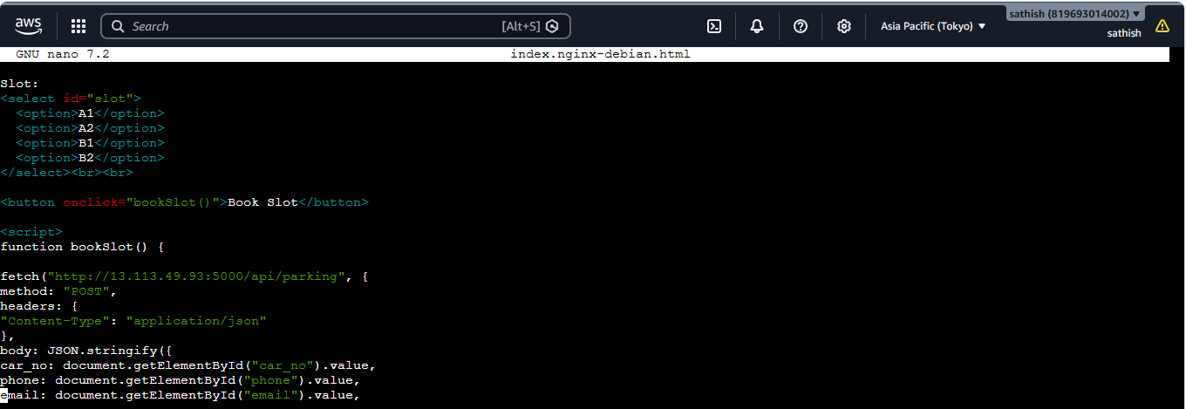

Slide 12
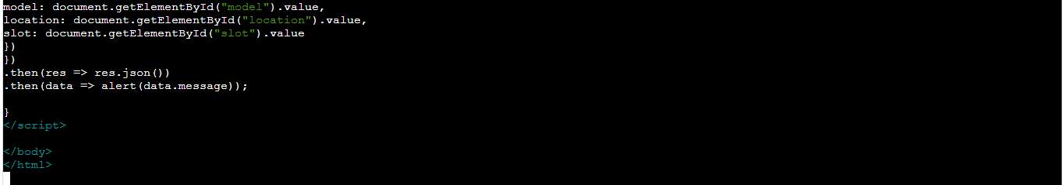
Backend code:
sudo ssh -i keypair.pem ubuntu@13.113.49.93
sudo apt update
sudo apt install python3 python3-pip python3-venv -y
python3 -m venv venv
source venv/bin/activate
pip install flask flask-cors pymysql

Slide 13
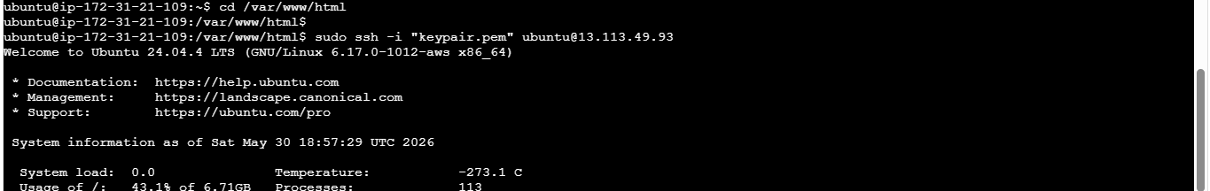
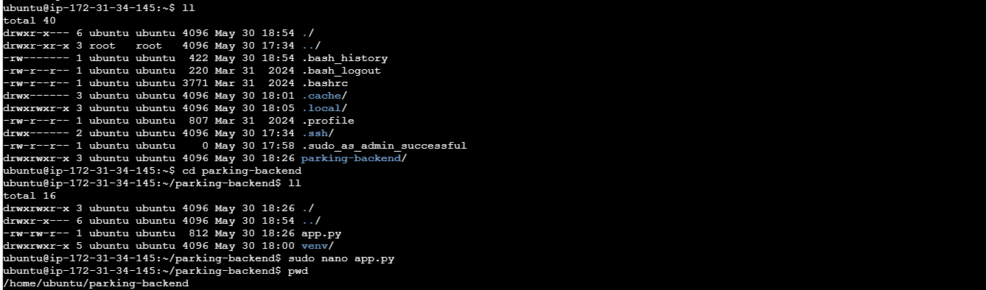

Slide 14
ubuntu@ip-172-31-34-145:~$ mkdir parking-backend
cd parking-backend
python3 -m venv venv
source venv/bin/activate
(venv) ubuntu@ip-172-31-34-145:~/parking-backend$
(venv) ubuntu@ip-172-31-34-145:~/parking-backend$ ls
venv
(venv) ubuntu@ip-172-31-34-145:~/parking-backend$ pwd
/home/ubuntu/parking-backend
(venv) ubuntu@ip-172-31-34-145:~/parking-backend$
(venv) ubuntu@ip-172-31-34-145:~/parking-backend$ pip install flask flask-cors pymysql
Collecting flask
Downloading flask-3.1.3-py3-none-any.whl.metadata (3.2 kB)
Collecting flask-cors
Downloading flask_cors-6.0.2-py3-none-any.whl.metadata (5.3 kB)
Collecting pymysql
Downloading pymysql-1.2.0-py3-none-any.whl.metadata (4.3 kB)
Collecting blinker>=1.9.0 (from flask)
Downloading blinker-1.9.0-py3-none-any.whl.metadata (1.6 kB)
Collecting click>=8.1.3 (from flask)
Downloading click-8.4.1-py3-none-any.whl.metadata (2.6 kB)

Slide 15
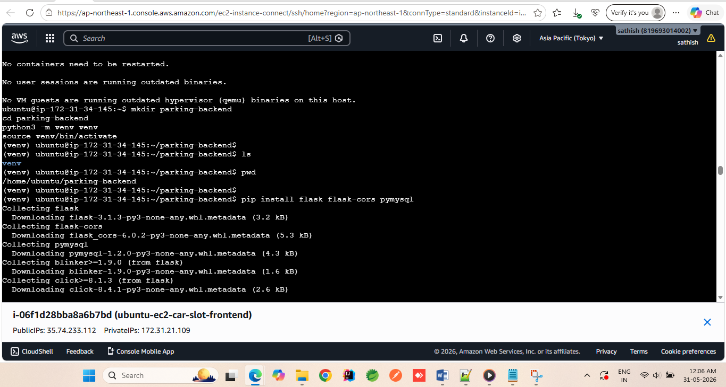
(venv) ubuntu@ip-172-31-34-145:~/parking-backend$ sudo apt install mysql-server -y
Reading package lists... Done
Building dependency tree... Done

Slide 16
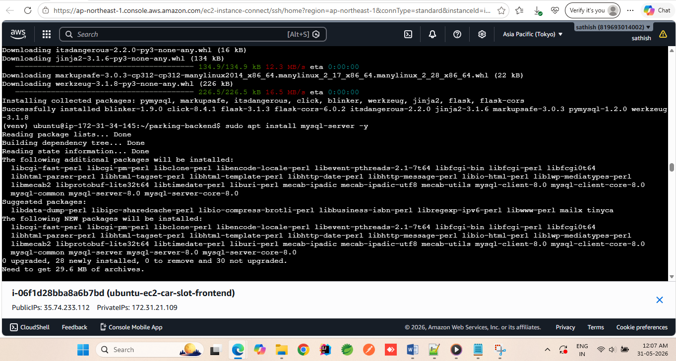

Slide 17
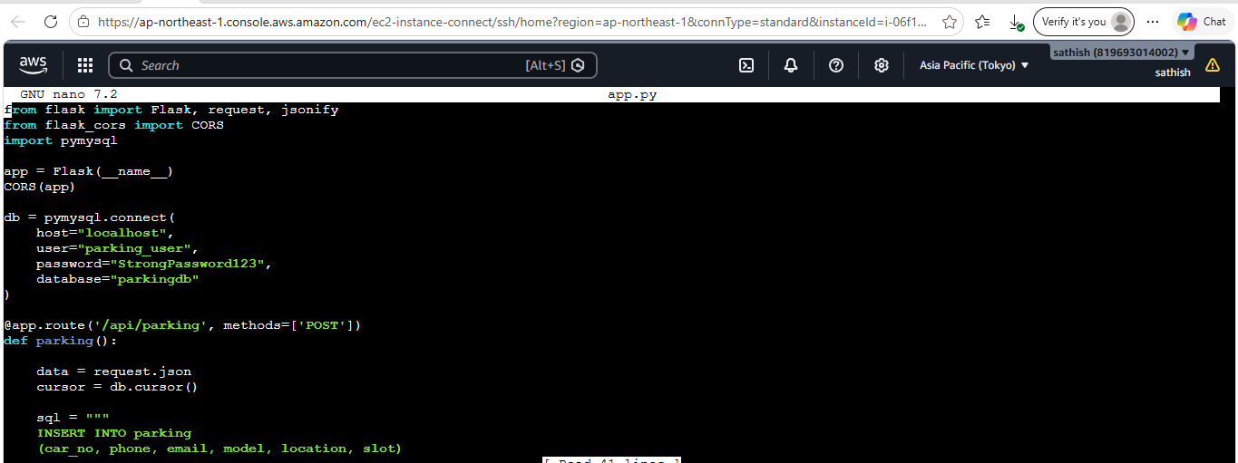


Slide 18
MYSQL Database :
sudo apt update
sudo apt install mysql-server –y
sudo systemctl start mysql
sudo systemctl enable mysql
sudo mysql
CREATE DATABASE parkingdb;
USE parkingdb;
(venv) ubuntu@ip-172-31-34-145:~/parking-backend$ sudo mysql
Welcome to the MySQL monitor. Commands end with ; or \g.
Your MySQL connection id is 10
Server version: 8.0.45-0ubuntu0.24.04.1 (Ubuntu)
Copyright (c) 2000, 2026, Oracle and/or its affiliates.
Oracle is a registered trademark of Oracle Corporation and/or its
affiliates. Other names may be trademarks of their respective
owners.
Type 'help;' or '\h' for help. Type '\c' to clear the current input statement.
mysql> CREATE DATABASE parkingdb;
Query OK, 1 row affected (0.01 sec)
mysql> USE parkingdb;
Database changed
(venv) ubuntu@ip-172-31-34-145:~/parking-backend$ sudo mysql
Welcome to the MySQL monitor. Commands end with ; or \g.
Your MySQL connection id is 10
Server version: 8.0.45-0ubuntu0.24.04.1 (Ubuntu)
Copyright (c) 2000, 2026, Oracle and/or its affiliates.
Oracle is a registered trademark of Oracle Corporation and/or its
affiliates. Other names may be trademarks of their respective
owners.
Type 'help;' or '\h' for help. Type '\c' to clear the current input statement.
mysql> CREATE DATABASE parkingdb;
Query OK, 1 row affected (0.01 sec)
mysql> USE parkingdb;
Database changed

Slide 19
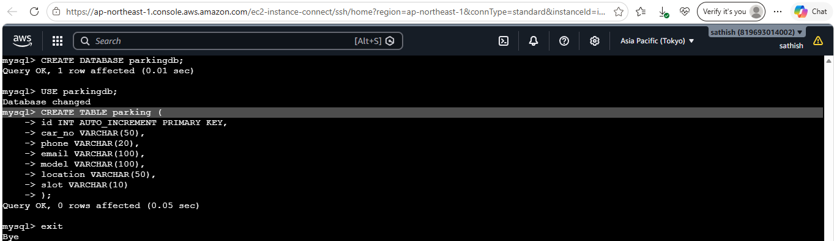
mysql> USE parkingdb;
Database changed
mysql> CREATE TABLE parking (
-> id INT AUTO_INCREMENT PRIMARY KEY,
-> car_no VARCHAR(50),
-> phone VARCHAR(20),
-> email VARCHAR(100),
-> model VARCHAR(100),
-> location VARCHAR(50),
-> slot VARCHAR(10)
-> );

Slide 20
mysql> CREATE USER 'parking_user'@'localhost' IDENTIFIED BY 'StrongPassword123';
Query OK, 0 rows affected (0.02 sec)
mysql> CREATE DATABASE parkingdb;
ERROR 1007 (HY000): Can't create database 'parkingdb'; database exists
mysql> GRANT ALL PRIVILEGES ON parkingdb.* TO 'parking_user'@'localhost';
Query OK, 0 rows affected (0.01 sec)
mysql> FLUSH PRIVILEGES;
Query OK, 0 rows affected (0.01 sec)
mysql> exit;

Slide 21
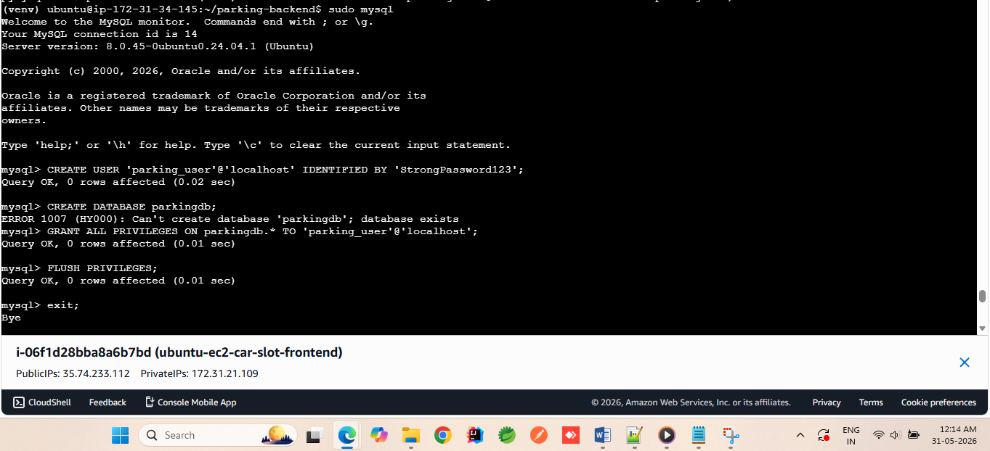
Phython run command:
python3 app.py

Slide 22
(venv) ubuntu@ip-172-31-34-145:~/parking-backend$ USE parkingdb;
USE: command not found
(venv) ubuntu@ip-172-31-34-145:~/parking-backend$ use parkingdb;
Command 'use' not found, did you mean:
command 'fuse' from deb fuse-emulator-gtk (1.6.0+dfsg1-2)
command 'fuse' from deb fuse-emulator-sdl (1.6.0+dfsg1-2)
command 'nse' from deb ns2 (2.35+dfsg-5)
command 'ase' from deb ase (3.22.1-3)
command 'muse' from deb muse (4.2.1-1)
Try: sudo apt install <deb name>
(venv) ubuntu@ip-172-31-34-145:~/parking-backend$ nano app.py
(venv) ubuntu@ip-172-31-34-145:~/parking-backend$
(venv) ubuntu@ip-172-31-34-145:~/parking-backend$ python3 app.py
* Serving Flask app 'app'
* Debug mode: off
WARNING: This is a development server. Do not use it in a production deployment. Use a production WSGI server instead.
* Running on all addresses (0.0.0.0)
* Running on http://127.0.0.1:5000
* Running on http://172.31.34.145:5000
Press CTRL+C to quit
157.51.183.12 - - [30/May/2026 18:28:01] "OPTIONS /api/parking HTTP/1.1" 200 -
157.51.183.12 - - [30/May/2026 18:28:01] "POST /api/parking HTTP/1.1" 200 -
157.51.183.12 - - [30/May/2026 18:31:23] "OPTIONS /api/parking HTTP/1.1" 200 -
157.51.183.12 - - [30/May/2026 18:31:24] "POST /api/parking HTTP/1.1" 200 -
^C(venv) ubuntu@ip-172-31-34-145:~/parking-backend$ sudo mysql
Welcome to the MySQL monitor. Commands end with ; or \g.

Slide 23
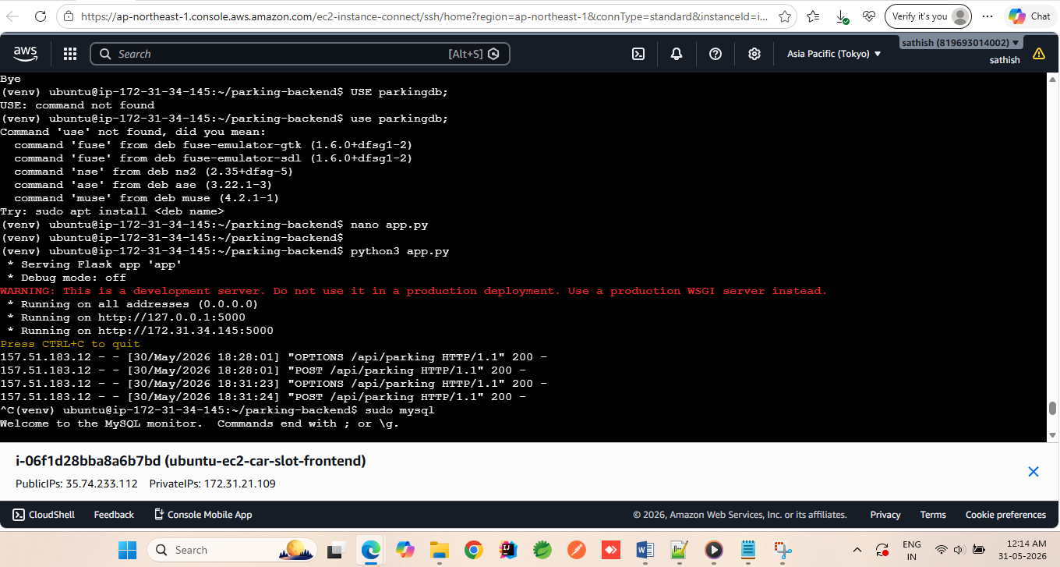

Slide 24
mysql> USE parkingdb;
Reading table information for completion of table and column names
You can turn off this feature to get a quicker startup with -A
Database changed
mysql> SHOW TABLES;
+---------------------+
| Tables_in_parkingdb |
+---------------------+
| parking |
+---------------------+
1 row in set (0.00 sec)
mysql> select * from parking;
+----+----------+------------+-------------------+---------------+----------+------+
| id | car_no | phone | email | model | location | slot |
+----+----------+------------+-------------------+---------------+----------+------+
| 1 | TN034567 | 8595949349 | sathish@gmail.com | swift vxi | Chennai | A1 |
| 2 | TN053467 | 8873987622 | vivek@gmail.com | hyundai avenu | Mumbai | A2 |
+----+----------+------------+-------------------+---------------+----------+------+
2 rows in set (0.00 sec)
mysql>

Slide 25
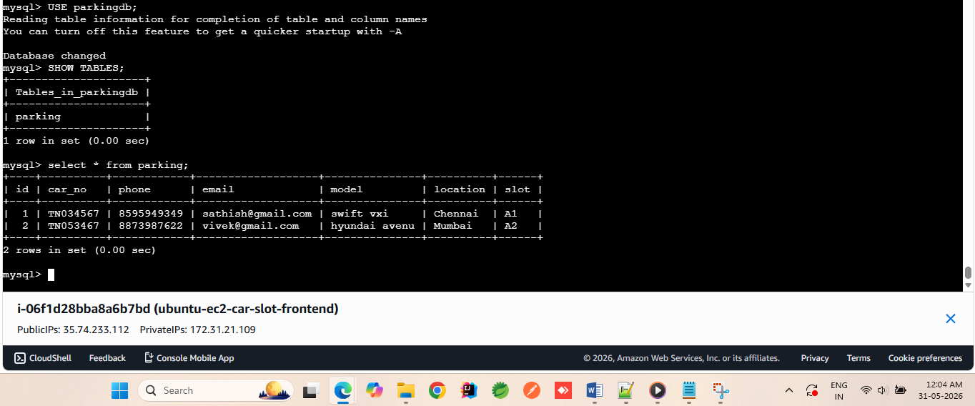

Slide 26
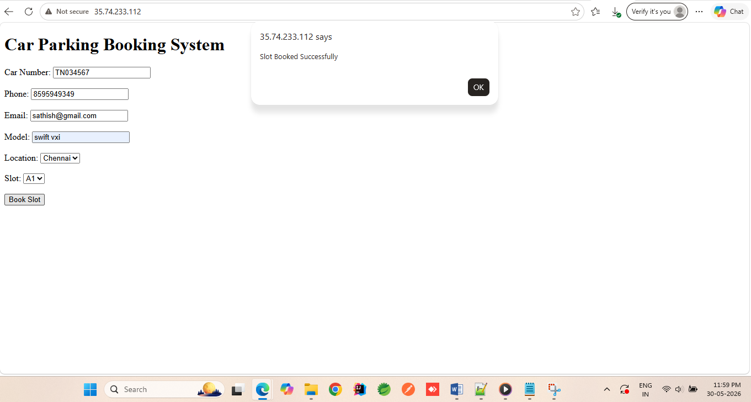
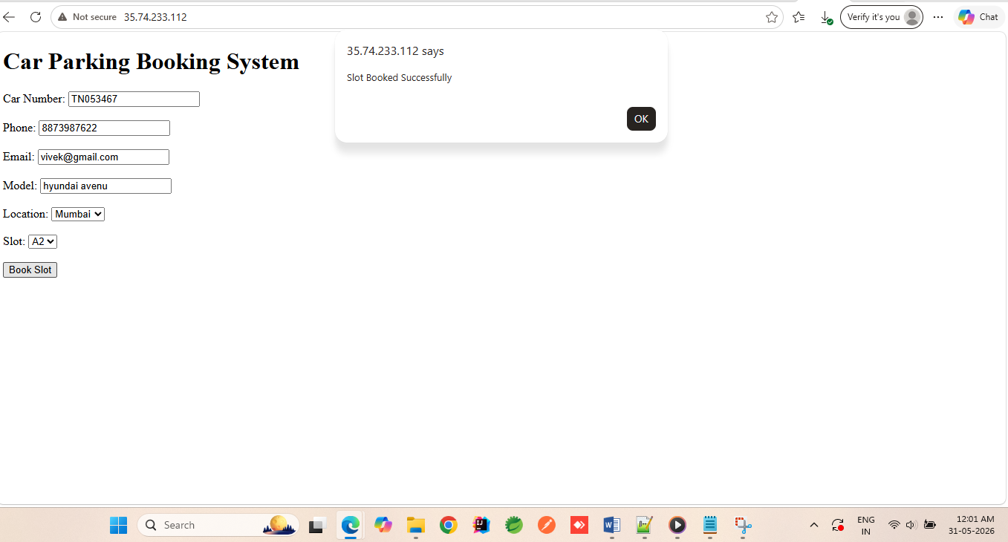

Slide 27
CONCLUSION
The AWS Multi-Tier Car Parking System successfully demonstrates a scalable cloud-based application using separate layers for presentation, business logic, and data storage.
The Frontend EC2 instance provides a user-friendly interface where users can enter car details such as car number, phone number, email, model, location, and parking slot.
The Backend EC2 instance runs a Python Flask application that processes user requests, validates data, and communicates with the database.
The MySQL Database EC2 instance securely stores parking registration records and booking information.
This three-tier architecture offers several benefits:
Scalability: Each tier can be scaled independently based on demand.
Security: Database access is restricted to the backend layer, improving data protection.
Maintainability: Frontend, backend, and database components can be managed and updated separately.
Reliability: Separation of services reduces the impact of failures and improves system stability.
When a user books a parking slot, the request flows from the frontend to the backend API, which stores the booking details in the MySQL database and returns a confirmation message. This architecture follows industry best practices for deploying web applications on AWS and provides a strong foundation for future enhancements such as user authentication, real-time slot availability, payment integration, email notifications, monitoring, and load balancing.
Overall, the project demonstrates how AWS EC2, Python Flask, HTML/CSS/JavaScript, and MySQL can be integrated to build a complete cloud-based Car Parking Management System using a multi-tier architecture.

